Slide 1
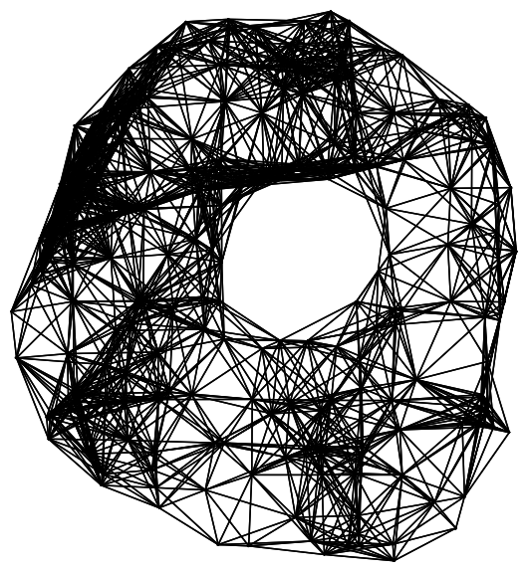
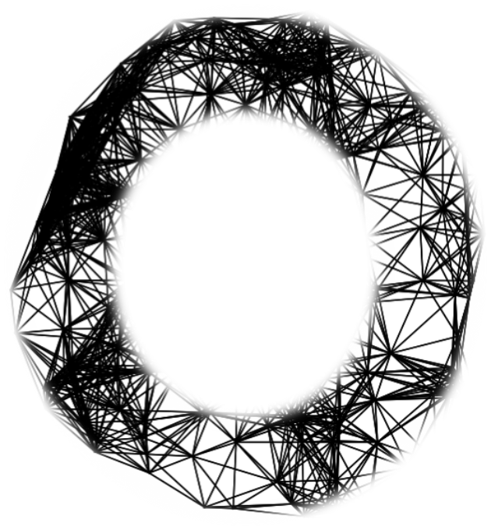
Computation of Persistent Homology Using the Delaunay-Rips Complex
An efficient family of simplicial complexes
for topological data analysis
Amish Mishra and Francis Motta

Slide 2
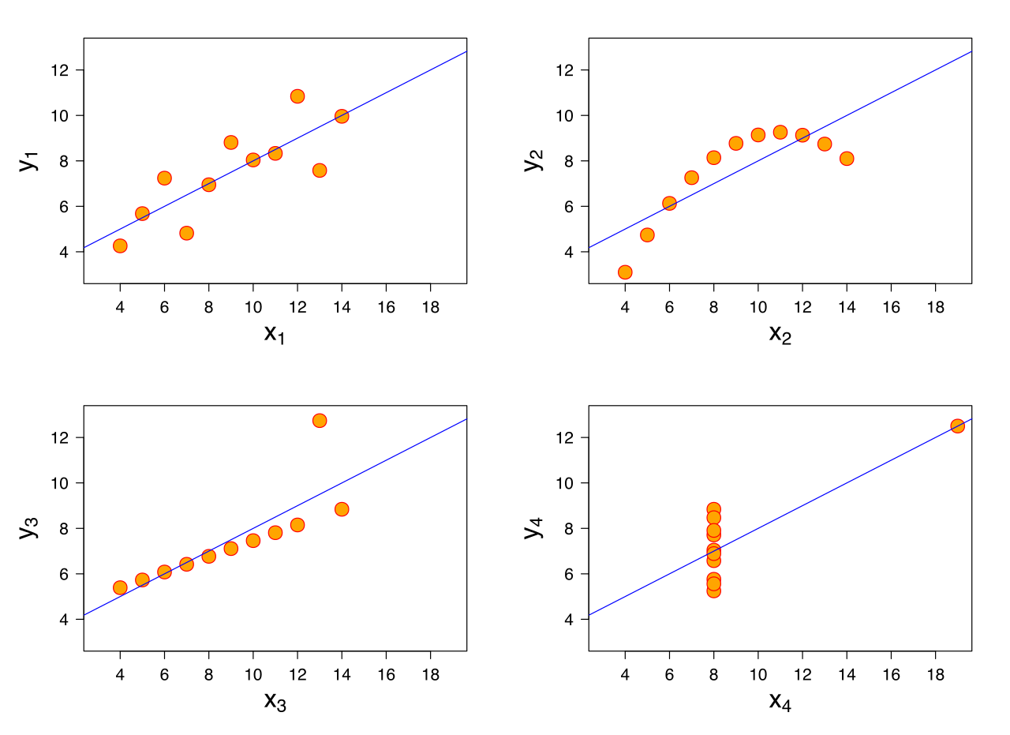
Anscombe’s Quartet
Notes:
Similar mean of x, y, sample variance of x and y, correlation, linear regression, R^2

Slide 3
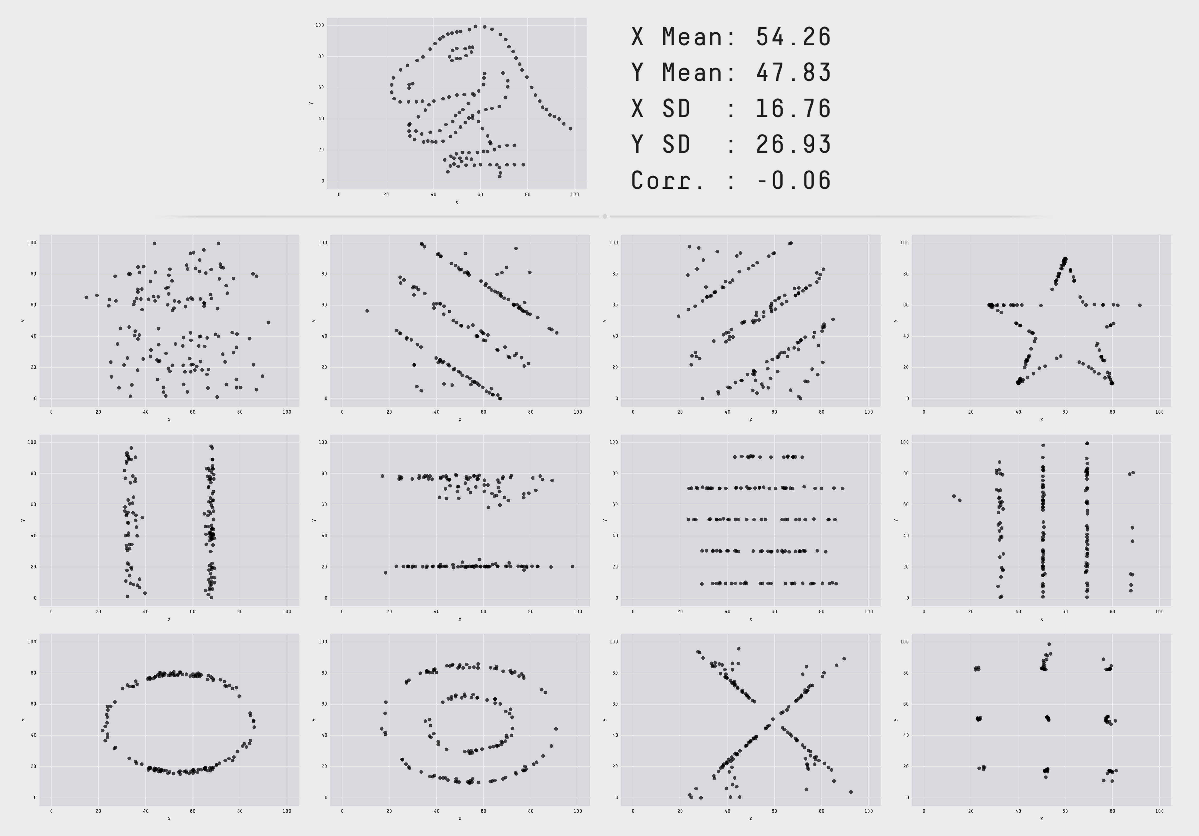
The Datasaurus Dozen
Notes:
https://www.autodesk.com/research/publications/same-stats-different-graphs

Slide 4
Problem

Slide 5
Problem
What if visualization is not an option?

Slide 6
TDA

Slide 7
TDA (Topological Data Analysis)
Quantify the qualitative features of data for computation and interpretation

Slide 8
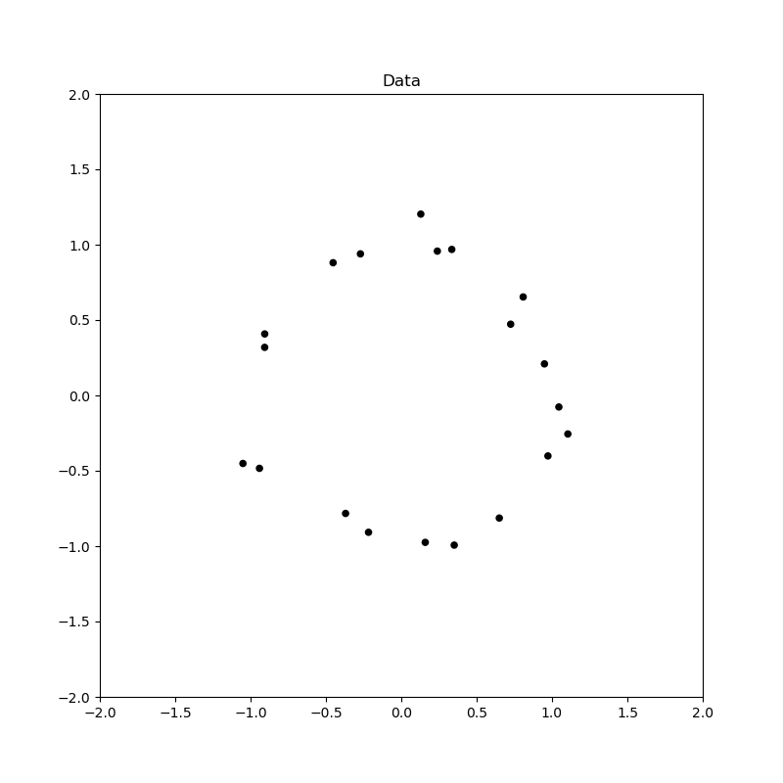
TDA (Topological Data Analysis)

Slide 9
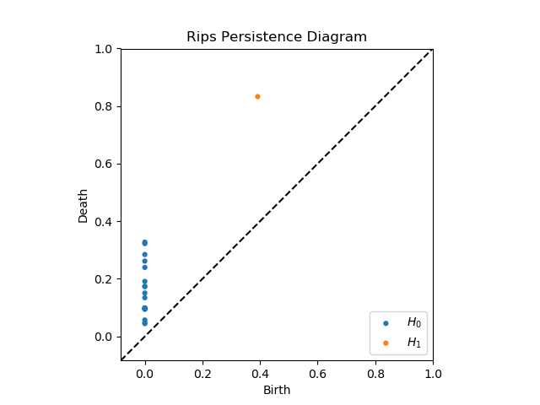
TDA (Topological Data Analysis)

Slide 10
TDA Applications
Protein folding video
Mobile data: https://epjdatascience.springeropen.com/articles/10.1140/epjds/s13688-015-0041-5
Brain arteries:
https://cdr.lib.unc.edu/concern/parent/c534fv18f/file_sets/ft848x10p
Notes:
PersGNN Krishnapriyan

Slide 11
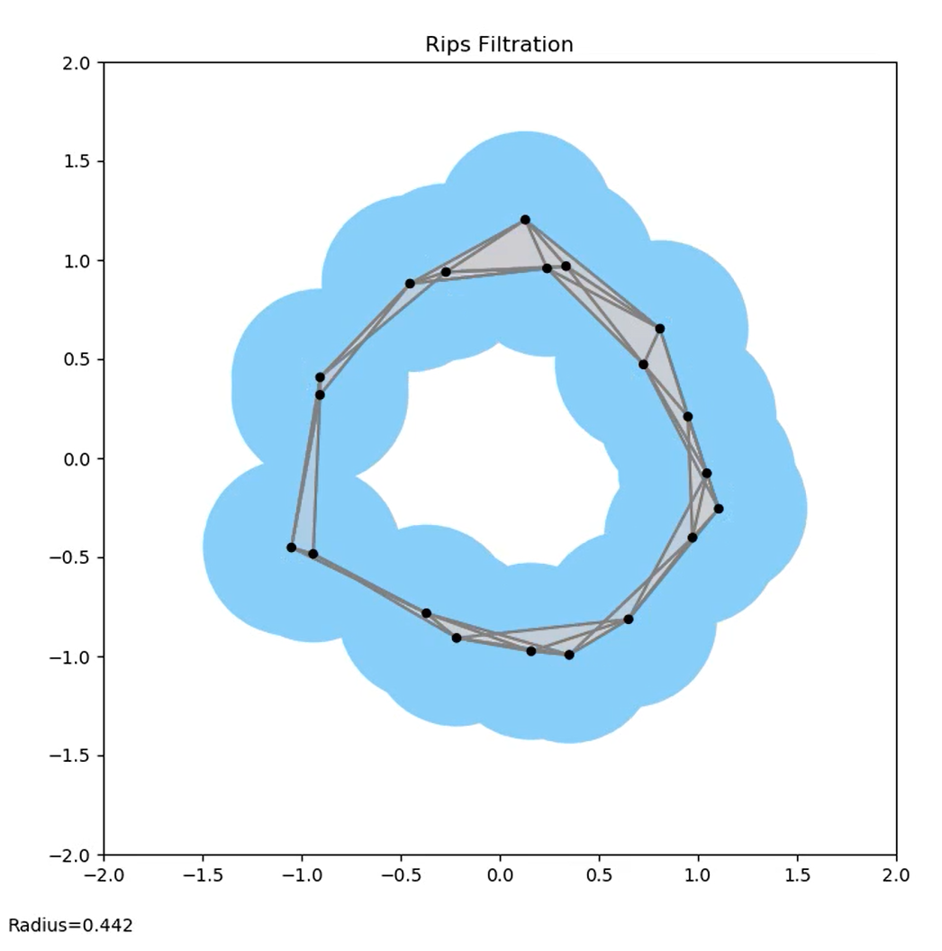
Big Idea Pipeline
Data
Persistence Diagram
Interpretation
Complex
One significant hole in the data

Slide 12
Buzz words
Data/Point cloud
picture

Slide 13
Buzz words
Complex/Topology
Picture

Slide 14
Buzz words
Persistence Diagram/Geometric Features
Picture of PD with complex to show correspondence

Slide 15
Main question:
Can we do it faster?

Slide 16
Rips

Slide 17
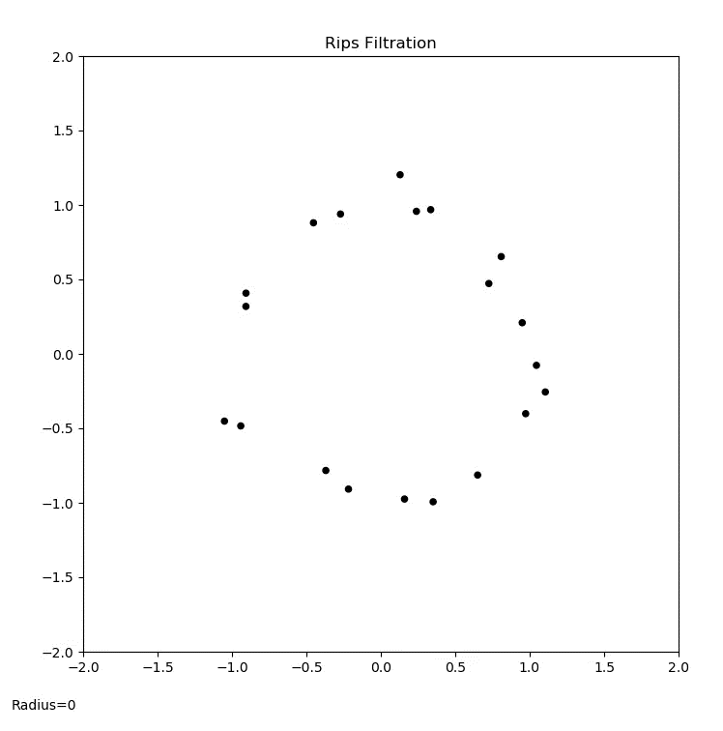
Rips animation

Slide 18
PD Interpretation

Slide 19
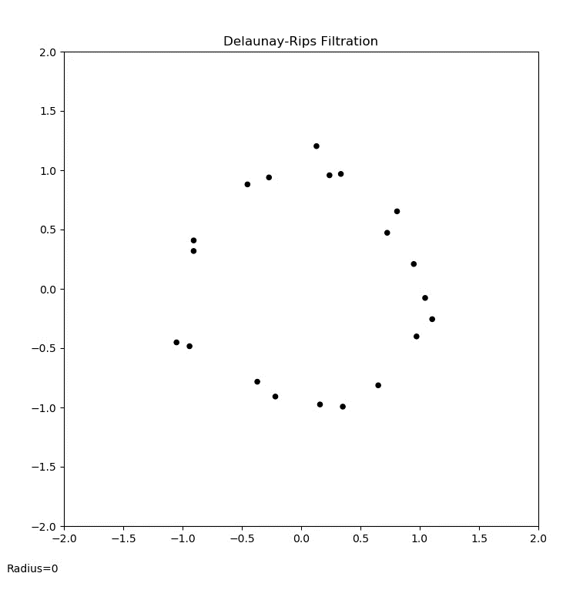
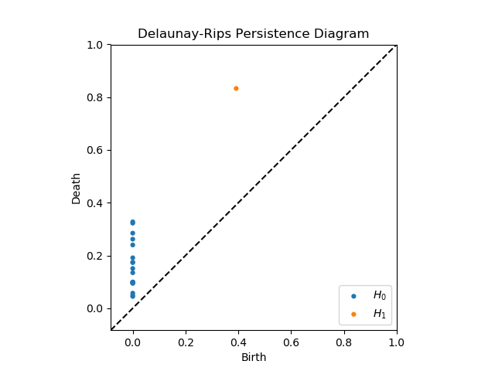
Del-Rips animation

Slide 20

PD Interpretation

Slide 21
Persistence diagram comparison

Slide 22
Run-time comparison

Slide 23
Synthetic Data application

Slide 24
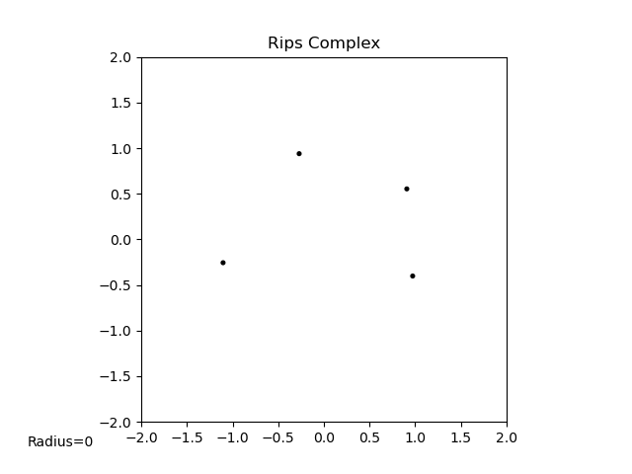
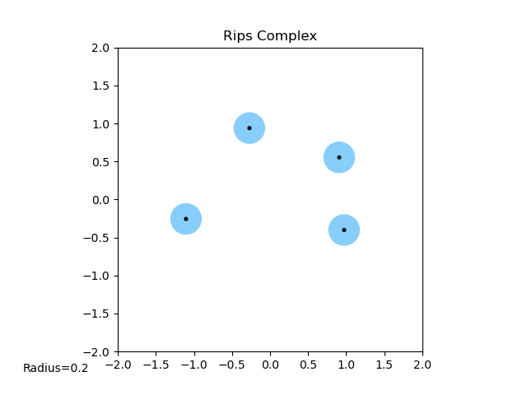
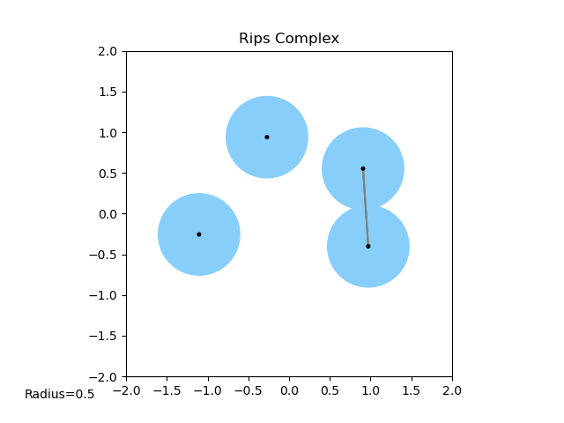
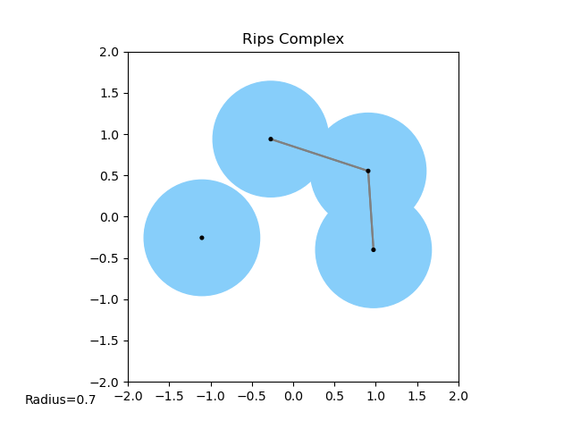
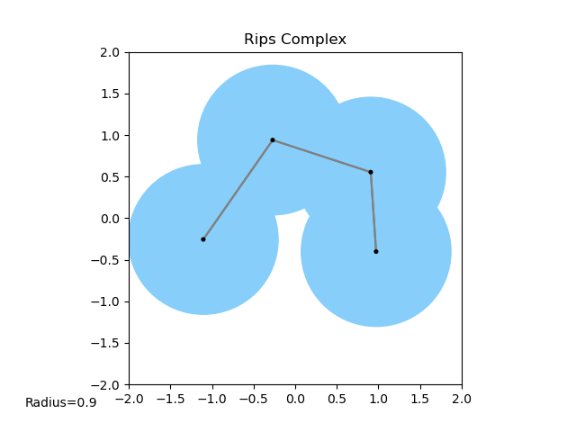
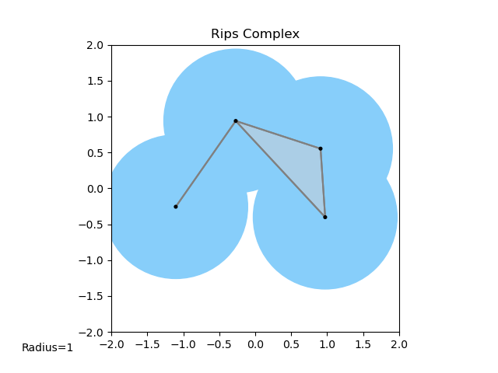
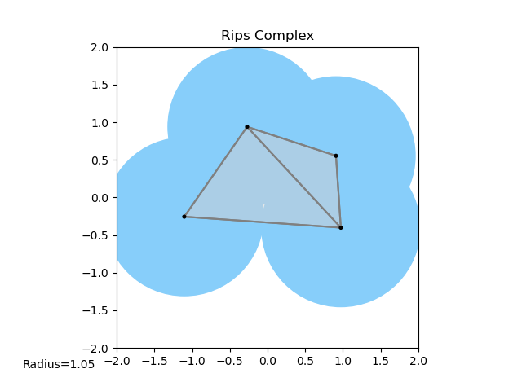
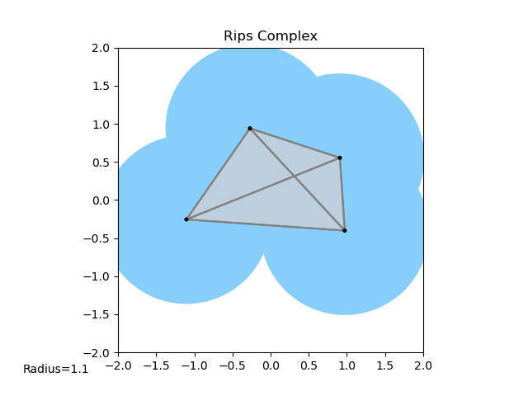
Definition of Rips

Slide 25
Definition of Delaunay Triangulation

Slide 26
Definition of Delaunay-Rips complex

Slide 27
Definition of filtration

Slide 28
Algorithm for building filtration

Slide 29
Question: How stable is this?

Slide 30
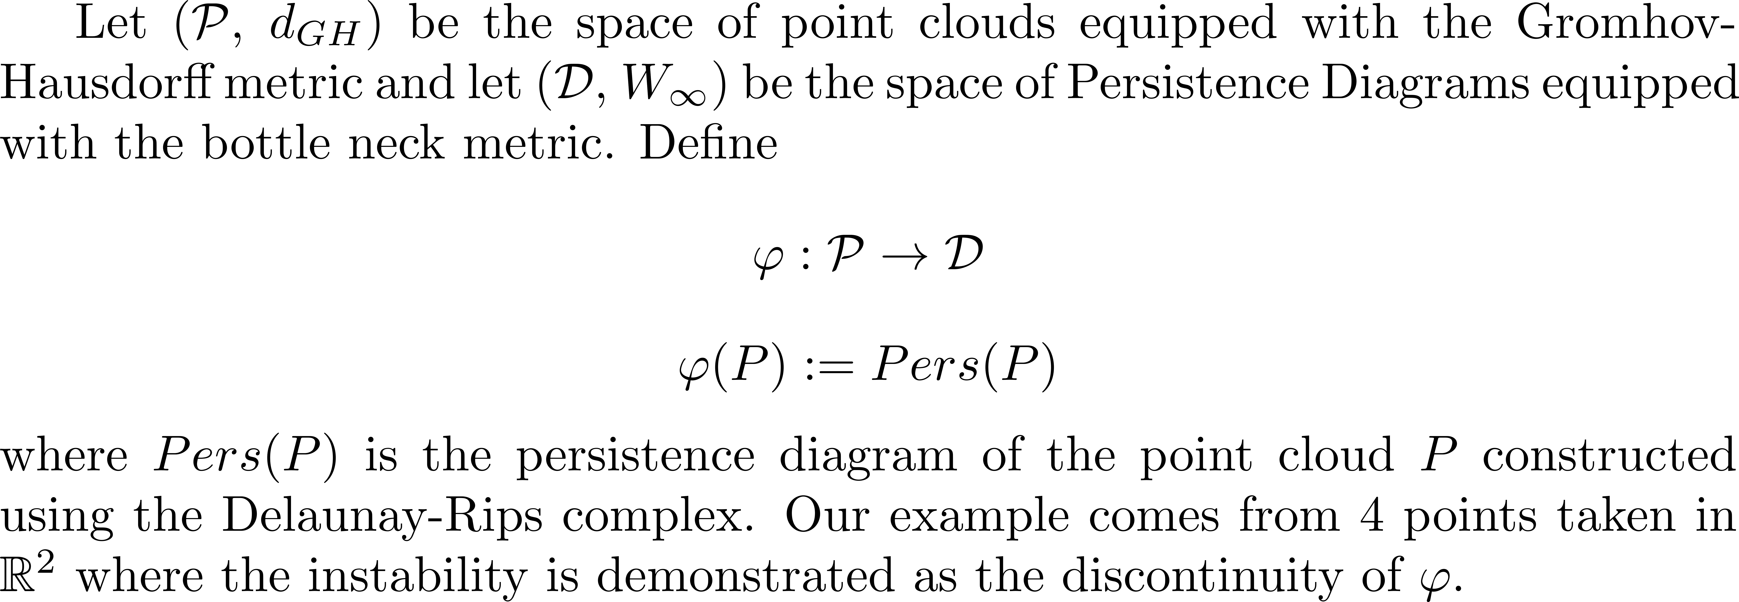
Math behind instability

Slide 31
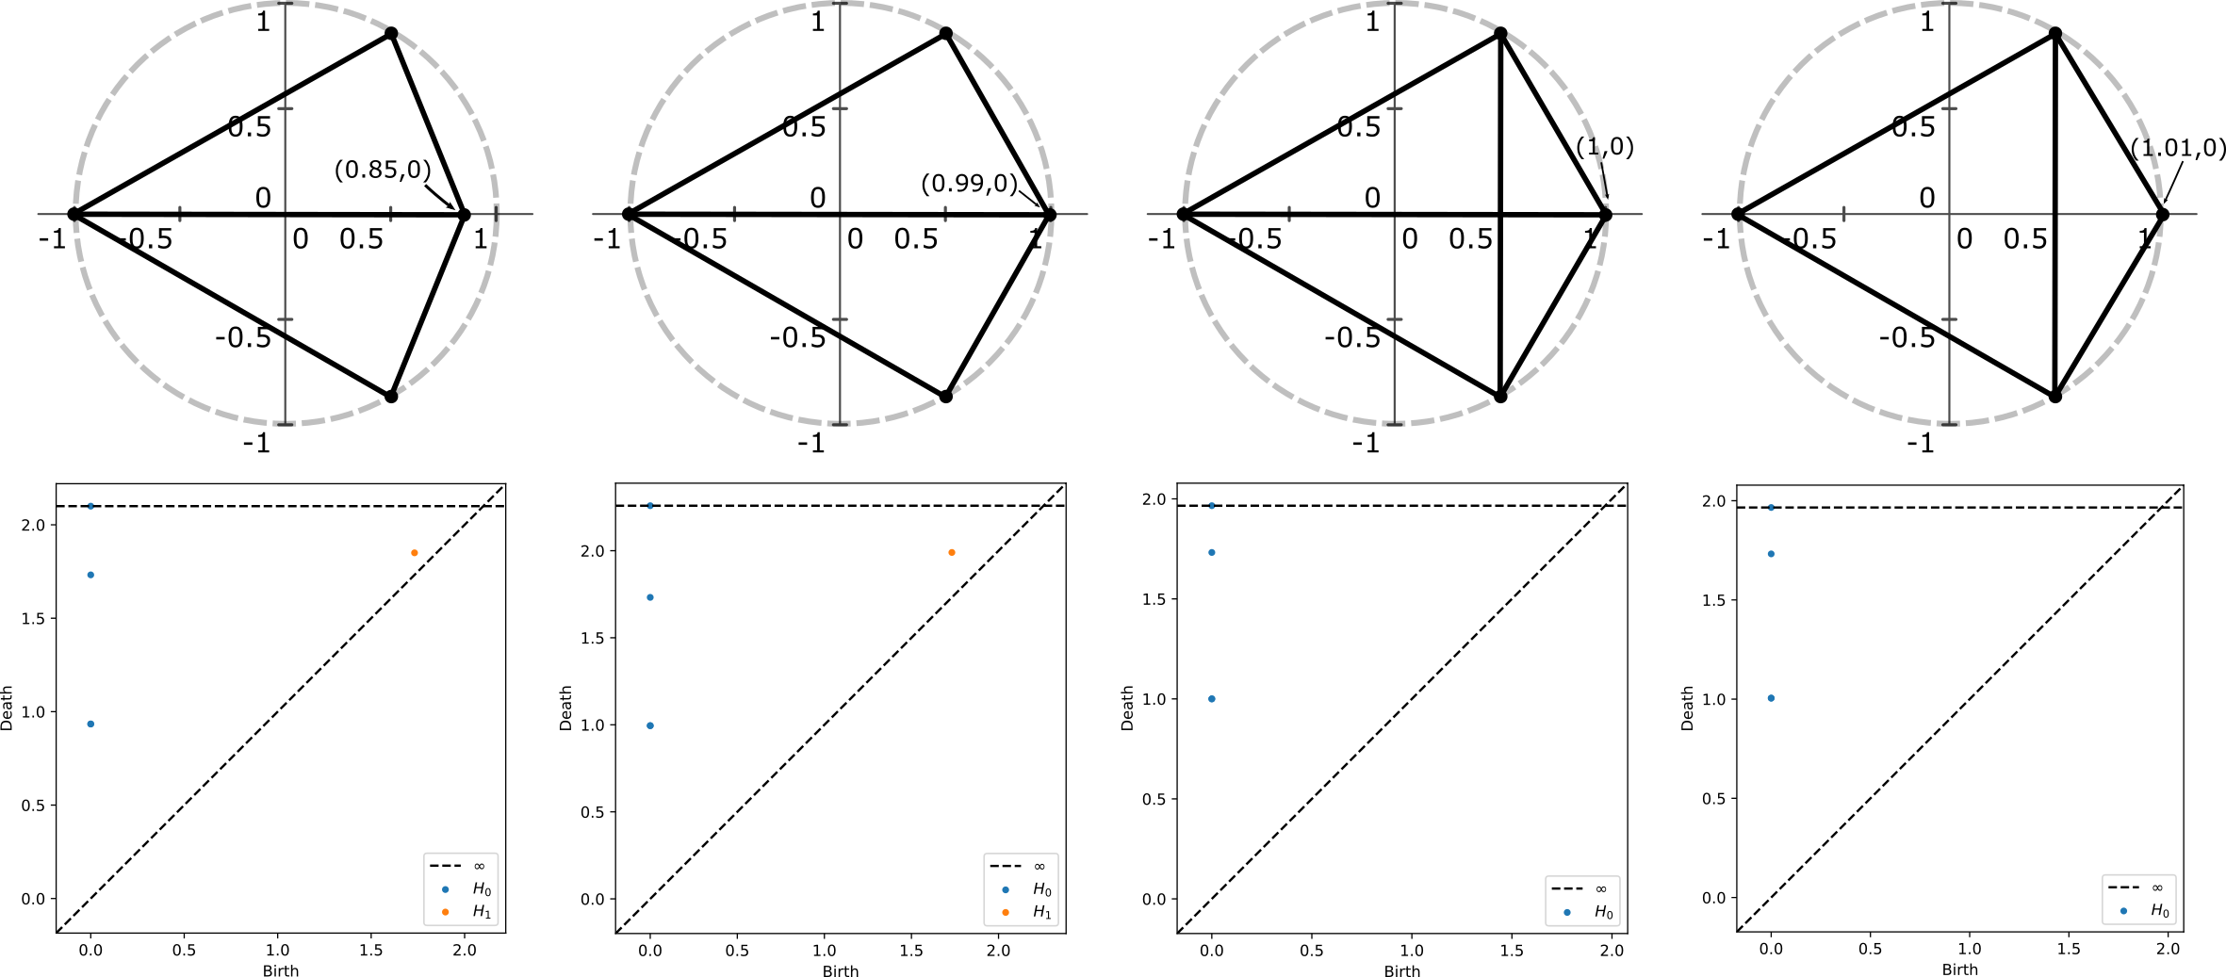

Slide 32
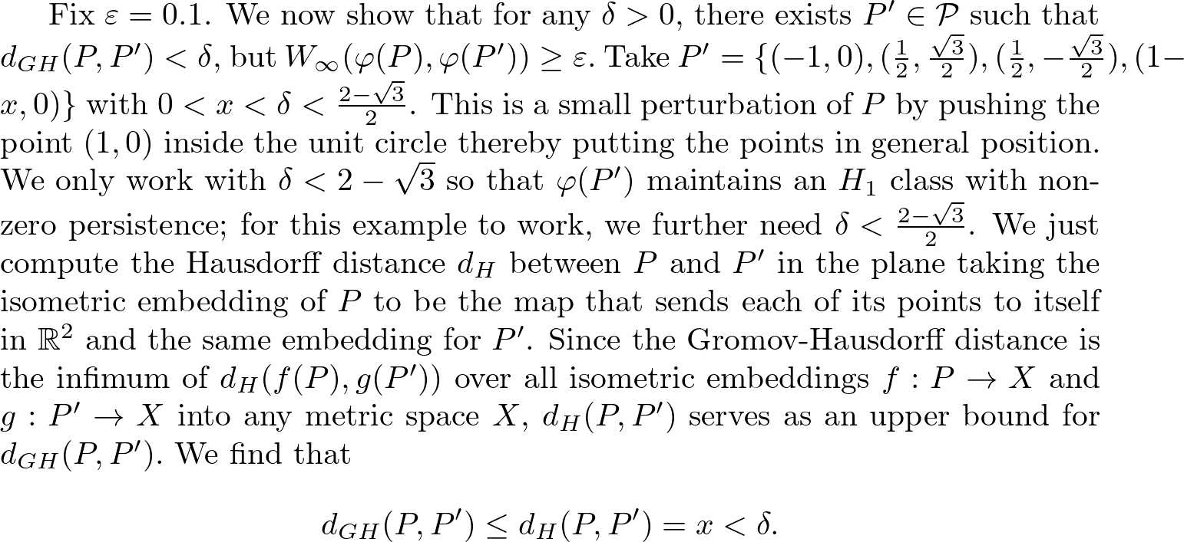

Slide 33
Visual 4 pt example of instability

Slide 34
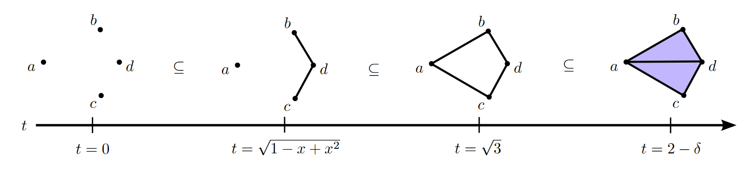
Aside

Slide 35
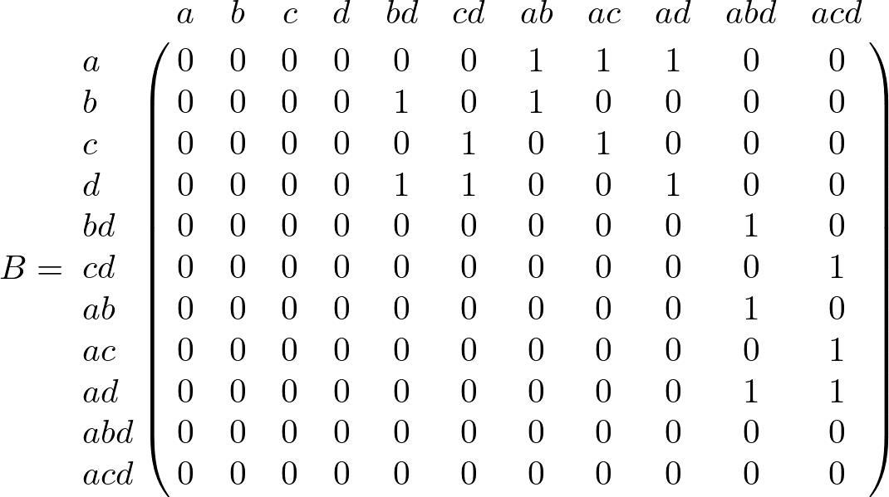

Slide 36
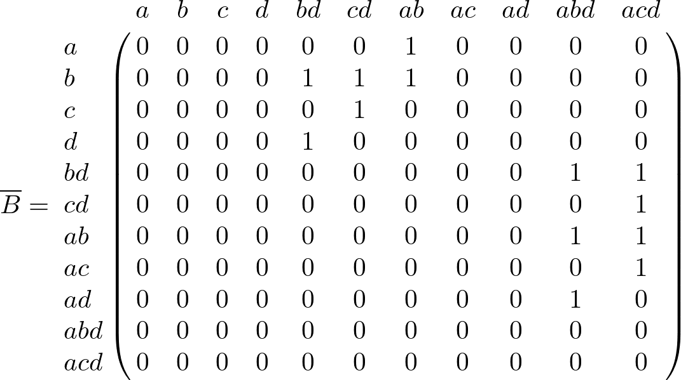

Slide 37
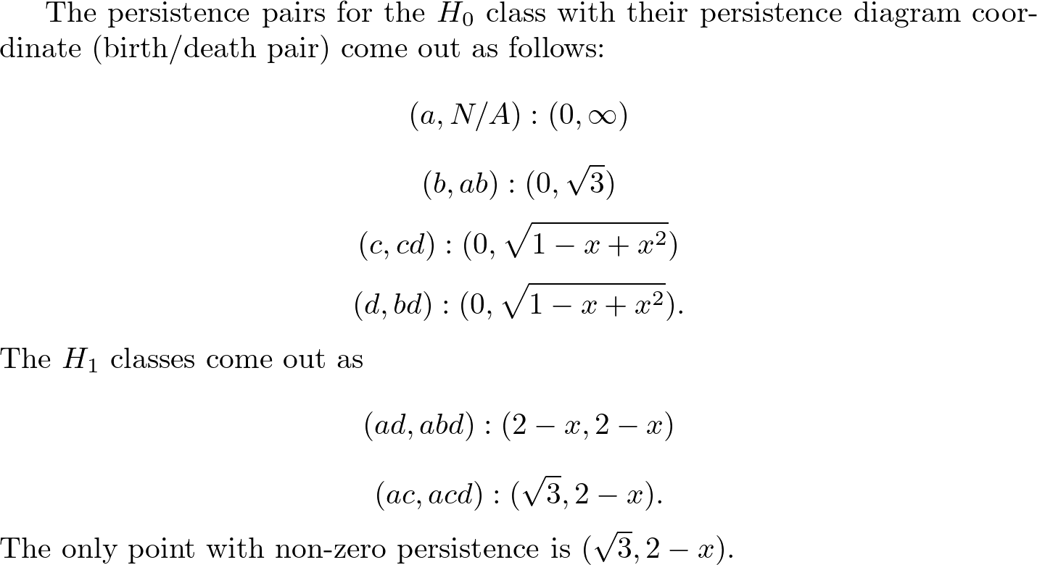

Slide 38
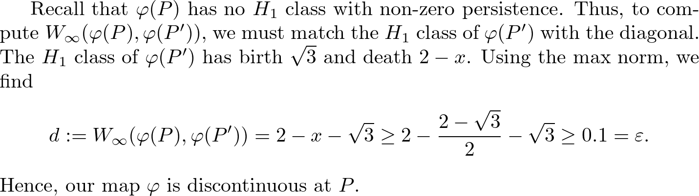

Slide 39
Conditions that guarantee stability
Theorem
Lemmas
Ideas behind lemma
Visuals of circumcenter moving and causing edge-flips in triangulation
Show when a Delaunay face exists and when it doesn’t
R^2 examples

Slide 40
Maintain Delaunay Triangulation!

Slide 41
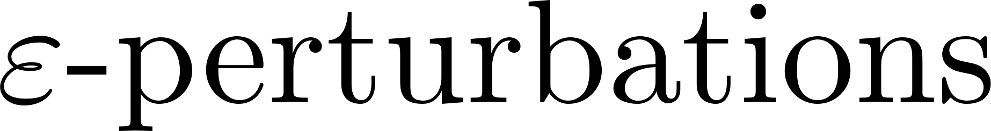
Existing work (Weller)

Slide 42
Apply to real data sets

Slide 43
Applications in ML

Slide 44
Proving stability for other TDA methods

Slide 45
Francis Motta

Slide 46
FAU

Slide 47
JMM

Slide 48
References

